Slide 1
Unit testing with JUnit
Presented by: <Srinivas Chellapilla>
Date: <14/06/2016>

Slide 2
About Me (Srinivas Chellapilla)
Technical Manager
Managing GatewayConnect, FTP Spoof, Enterprise Message Handler,XML solutions for PSTechnolgy and REM
Associated with Prokarma for past 10 yrs
Also part of the development team which delivered one of the 1st projects for Prokarma (previously eSymbiosis)

Slide 3
PRESENTATION AGENDA
Unit Testing
Benefits
Introduction to JUnit
JUnit Test Case lifecycle
Traditional and TDD approaches
Sample test cases
Mocking frameworks for Unit testing

Slide 4
Unit Test your code
What is a Unit?
Procedural language
Object Oriented language
Why Test a Unit?

Slide 5
Benefits
Reduces risk in highly complex projects
Provides documentation
Allows you to come up with good design

Slide 6

Myth Buster
Developer’s view :-
Why should I test my code?
That’s what QA is paid for !!

Slide 7
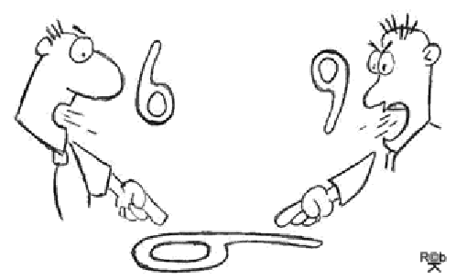
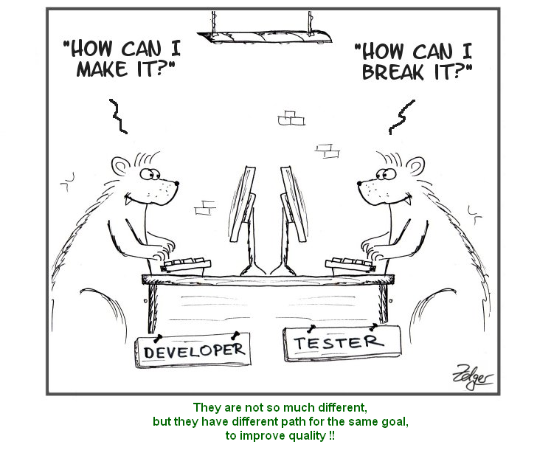
Developers Vs. Testers

Slide 8
Some Unit Testing frameworks
Java -JUnit , TestNG
C -cUnit
C++ - cpUnit
Fortran - FUnit
Came to be known as xUnit frameworks

Slide 9
Introduction to JUnit
Eclipse set up etc.

Slide 10
JUnit test lifecycle
Test lifecycle has 4 phases: Setup, exercise,verify, teardown
setUp()
test() -> exercise, verify
tearDown()

Slide 11
With Annotations..
@BeforeClass
@AfterClass
@Before
@Test
@After

Slide 12
Assertions
assertTrue
assertFalse
assertEquals
assertNull
assertNotNull
All these assertions come with a flavor of optional Assertion Message when assertion fails

Slide 13
Asserting for double values
Use of delta when testing expected "double" type values

Slide 14
Testing in Waterfall and Agile models

Slide 15
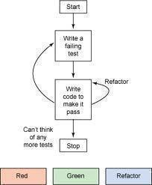
Test Driven Development

Slide 16
TDD explained..
Write the Test first
Write code to make the test pass

Slide 17
Benefits of TDD
Helps you find defects early and Cost of Testing is reduced
Improved code design

Slide 18
System Under Test (SUT)
Test only SUT
State Verification by Asserting expected values
Behavior Verification - by verifying expected interactions of SUT with depended-on-components (DOC)

Slide 19
Testing Exceptions with JUnit
Using Try, Catch
Expecting Exception( Use with care!)
Expected Exception rule

Slide 20
Test Exceptions using try,catch
try {
//Call the metod to be tested
fail("exception expected");/* don't forget to fail if you mandatorily expect exception here.*/
} catch (XXXException e) { Assert.assertEquals("expected message", e.getMessage());
}

Slide 21
Expecting Exceptions
@Test(expected=xxxException.class)
Due care is recommended
The tests may pass even when exceptions of expected type being thrown from elsewhere in code where you don't expect.
ex:@Test(expected=NullPointerException.class) //bad usage.

Slide 22
Test Exceptions using Junit Rule
@Rule
public ExpectedException thrown = ExpectedException.none();
In test method specify
Expected exception
ex:thrown.expect(XXXException.class);
Expected exception message
ex:thrown.expectMessage("expected");

Slide 23
Parameterized Tests
Helps in repeating a series of tests executing the same method with different sets if test input data.

Slide 24
Test Doubles
Dummy objects
Stubs
Mocks

Slide 25



Analogy body doubles..

Slide 26
Mocking frameworks for Java
EasyMock, JMock, Mockito

Slide 27
Primer using mocking frameworks
Verify if certain interactions with dependencies occured
Also verify the exact number of interactions with dependencies
Verify the order in which interactions happen

Slide 28
Primer using mocking frameworks
How to stub methods?
when(mock.doSomeThing()).thenReturn()

Slide 29
Primer using mocking frameworks
Methods stubbing can also be chained
when(mock.doSomeThing()).thenReturn().thenReturn().......

Slide 30
Primer using mocking frameworks
How to stub void methods?
when(mock.doSomeThing()).thenAnswer()
when(mock.doSomeThing()).thenDoNothing()
(Rarely used as mocks by default don't do anything with void methods)

Slide 31
Primer using mocking frameworks
Argument matchers

Slide 32
Primer using mocking frameworks
Argument captors can be used to test the state of arguments(helpful in testing void methods)

Slide 33
Best practices
Test should exercise only a single path of code
Test in Isolation
Tests which interact with database should not ideally make any permanent changes to database.(Use rollback)
Do not comment out tests. There is a way to disable tests! – use @Ignore

Slide 34
Test naming conventions
Should describe input conditions and expected outcome

Slide 35
Test code reuse
All OOP best practices like reuse should be followed for tests too

Slide 36
Code coverage
EclEmma tool in eclipse
Line coverage
Branch coverage

Slide 37

Code coverage myths
I have 100% code coverage. So is my code error free?

Slide 38
Unit testing pitfalls
Only happy path scenarios tested

Slide 39
DbUnit
Thumb rule – Database original state shouldn’t be modified after running unit tests - why because…?

Slide 40
DbUnit - features
Extract data from database into XML dataset
Restore DB to original state after every test.

Slide 41
Further reading
http://martinfowler.com/articles/mocksArentStubs.html
Xunit Test patterns – Gerald Meszaros
http://www.mkyong.com/unittest/junit-4-tutorial-6-parameterized-test/

Slide 42
Conclusions
assertTrue (“Unit testing is developer’s responsibility”)
assertFalse(“100% code coverage means error free code)
assertTrue(“Each test should test only one path of code”)

Slide 43
Reach Me @
greach@prokarma.com
817-914-3058

